Slide 1
Complexity theory
Part 1

Slide 2
Contents
INTRODUCTION 3
P class 4
NP class 5
P versus NP 10
Polynomial time reduction 13

Slide 3

Introduction
In Computer Science the problems can be categorized as
optimization (maximization or minimization) problems
decision problems

Slide 4
Optimization problems
objective - to maximize or minimize some values.
For example,
  Finding the minimum number of colors needed to color a given graph.
  Finding the shortest path between two vertices in a graph.

Slide 5
Decision Problem
problems for which the answer is a Yes or a No.
These types of problems are known as decision problems.
For example,
  Whether a given graph can be colored by only 4-colors.
  Finding Hamiltonian cycle in a graph is not a decision problem, whereas checking a graph is Hamiltonian or not is a decision problem.

Slide 6
Cost and Complexity
Algorithm complexity can be expressed in Order notation, e.g. “at what rate does work grow with N?”:
O(1) Constant
O(logN) Sub-linear
O(N) Linear
O(NlogN) Nearly linear
O(N²) Quadratic
O(X^{N}) Exponential
But, for a given problem, how do we know if a better algorithm is possible?

Slide 7
Polynomial time Algorithms
Most algorithms we have studied are polynomial time algorithms
That is -on inputs of size n, their worst-case running time is O(n^{k} )for some constant k.
problems that are solvable by polynomial-time algorithms as being tractable or easy

Slide 8
Non-polynomial time algorithms
all problems can not be solved in polynomial time.
For example, there are problems, such as Turing’s famous “Halting Problem,” that cannot be solved by any computer, no matter how much time we allow.
There are also problems that can be solved, but not in time is O(n^{k} ) for any constant k.
problems that require superpolynomial time as being intractable, or hard.

Slide 9
Tractable and intractable problems
Tractable-
Problems solvable by polynomial time algorithms
Intractable –
Problems that require super polynomial time

Slide 10

Deterministic and Non-Deterministic Algorithms

Slide 11
Deterministic Algorithms :
Those having the property that the result of every operation is uniquely defined
Non-Deterministic Algorithms :
Those containing operations whose outcomes are not uniquely defined,
are limited to specified set of possibilities
Deterministic and Non-Deterministic Algorithms

Slide 13
To specify such nondeterministic algorithms, we use three functions
Choice(S) : arbitrarily choose one of the element of set S.
Failure() : signals an unsuccessful completion.
Success() : signals a successful completion.

Slide 14
Linear Search Algorithm
Nondeterministic Algorithm
j=Choice(1,n);
//Select an integer value in the range[1.n]
If a [j]=x then
{
write (j);
Success();
}
Write(0);
Failure();
Complexity O (1)
Deterministic Algorithm
For i=1 to n do
{
if (a[i]==x) then
{
write(Element is present);
}
}
If (i>n)
write(Element is not present);
Complexity O (n)

Slide 15
Non-Deterministic Machine
A machine which is capable of executing a nondeterministic algorithm is called nondeterministic machine .
1
This machine has the ability to select a “correct” element from the set of allowable choices.
2
The question of “how “ is not relevant because such a machine is purely fictitious
3

Slide 16
Complexity classes

Slide 17
Computational theory
In computer science, there exist some problems whose solutions are not yet found
the problems are divided into classes known as Complexity Classes.
a Complexity Class is a set of problems with related complexity.
These classes help scientists to groups problems based on how much time and space they require to solve problems and verify the solutions.
Computational theory is the branch of the theory of computation that deals with the resources required to solve a problem. -The common resources are time and space,

Slide 18
Complexity classes
P Class
NP Class
NP hard
NP complete

Slide 19

Class- P problems
Most of the algorithms we have looked at so far have been polynomial-time algorithms .
On inputs of size n, their worst-case running time is O(n^k) for some constant k
The general class of questions for which some algorithm can provide an answer in polynomial time is called "class P" or just "P”
These problems are called tractable,

Slide 20

Features:
The solution to P problems is easy to find.
P is often a class of computational problems that are solvable and tractable.
Tractable means that the problems can be solved in theory as well as in practice. But the problems that can be solved in theory but not in practice are known as intractable.
This class contains many natural problems like:
Calculating the greatest common divisor.
Finding a maximum matching.

Slide 21

Sample Problems in P
Fractional Knapsack
MST
Sorting

Slide 22
Class NP
The class NP consists of those problems that are verifiable in polynomial time.
NP is the class of decision problems for which it is easy to check the correctness of a claimed answer, with the aid of a little extra information.
Hence, we aren’t asking for a way to find a solution, but only to verify that an alleged solution really is correct.
Every problem in this class can be solved in exponential time using exhaustive search.
NP means non-deterministic polynomial time . It is the collection of decision problems that can be solved by a non-deterministic machine in polynomial time.

Slide 23

Features:
The solutions of the NP class are hard to find since they are being solved by a non-deterministic machine, but the solutions are easy to verify.
Problems of NP can be verified by a Turing machine in polynomial time
Eg-
Boolean Satisfiability Problem (SAT).
Hamiltonian Path Problem.
Graph coloring.

Slide 24

Class-P versus Class - NP
Every decision problem that is solvable by a deterministic polynomial time algorithm is also solvable by a polynomial time non-deterministic algorithm.
P is the set of all decision problems solvable by deterministic algorithms in polynomial time.
NP is the set of all decision problems solvable by nondeterministic algorithms in polynomial time.or can be verified in polynomial time.
All problems in P can be solved with polynomial time algorithms, whereas all problems in NP are intractable

Slide 25
It is not known whether P = NP.
However, many problems are known in NP with the property that if they belong to P, then it can be proved that P = NP.
If P ≠ NP, there are problems in NP that are neither in P nor in NP-Complete.
The problem belongs to class P if it’s easy to find a solution for the problem. The problem belongs to NP, if it’s easy to check a solution that may have been very tedious to find.

Slide 26
Class-P versus class - NP
Relationship :
P NP
The most famous unsolved problem in computer science is whether P= NP or P ≠ NP
Here it is assumed that P ≠ NP and P is considered as a subset of NP
NP
P

Slide 27
Consider the following example
Does there exist x in set {1,2,…,1000} such that x∗x=300 ?
Do there exist x,y,z in set {1,2,…,10} such that x∗y∗z+x∗y^3∗z+17∗x∗y∗z^2=4564 ?
Do there exist a,b,c in set {1,2,…,10} such that 17∗a∗b∗c^2+a∗b∗c+a∗b^3∗c=4564?

Slide 28
Reducibility
Definition : L1 and L2 be two problems. Problem L1 reduces to L2 iff there is a way to solve L1 by a deterministic polynomial time algorithm using a deterministic algorithm that solves L2 in polynomial time.
Denotted by L1< _{p} L2 or L1 α L2

Slide 29
The above definition implies that if we have a polynomial time algorithm for L2 , then we can solve L1 in polynomial time .
The notation is “α” ie L1 α L2 means L1 reduces to L2.
“α” is a transitive relation ( ie L1 α L2 and L2 α L3, then L1 α L3 ).

Slide 30
NP hard & NP Complete(NPC) problems

Slide 31
Definition for NP-Hard and NP Complete
NP-hardness (non-deterministic polynomial-time hardness), in computational complexity theory
is the defining property of a class of problems that are, informally, "at least as hard as the hardest problems in NP".
More precisely, a problem H is NP-hard when every problem L in NP can be reduced in polynomial time to H; that is, assuming a solution for H takes 1 unit time, we can use H‎'s solution to solve L in polynomial time

Slide 32
NP Complete problem
A problem L is NP- Complete iff
L is NP- Hard and
L є NP.

Slide 33
Commonly believed relationship among P, NP,
NP- Complete and NP- Hard problems
NP
NP-hard
P
NP-complete

Slide 34
If want to prove that a problem L is NP complete , we need to prove
1) L is NP
2) L is NP hard - that is a problem L is NP-hard when every problem H in NP can be reduced in polynomial time to L
H < P L

Slide 35
A problem that is NP complete has the property that it can be solved in polynomial time. Iff all other NP –complete problems can also solved in polynomial time.
If an NP-hard problem can be solved in polynomial time , then all NP complete problems can be solved in polynomial time.
All NP-complete problems are NP-Hard, but some NP-Hard problems are not known to be NP-Complete.

Slide 36
Clique problem

Slide 37
What is a complete graph?
1
1
2
1
22
3
2
4
33
These are examples of complete graph-
in every graph there is an edge connecting to all other vertices.

Slide 38
One Property of complete graph is
If |V| indicates number of vertices in G,
|V|=n
|E|= n(n+1)/2
Fig-1→ complete graph of 4 vertices
Fig 2→ complete graph of 3 vertices
Fig 3→ complete graph of 2 vertices

Slide 39
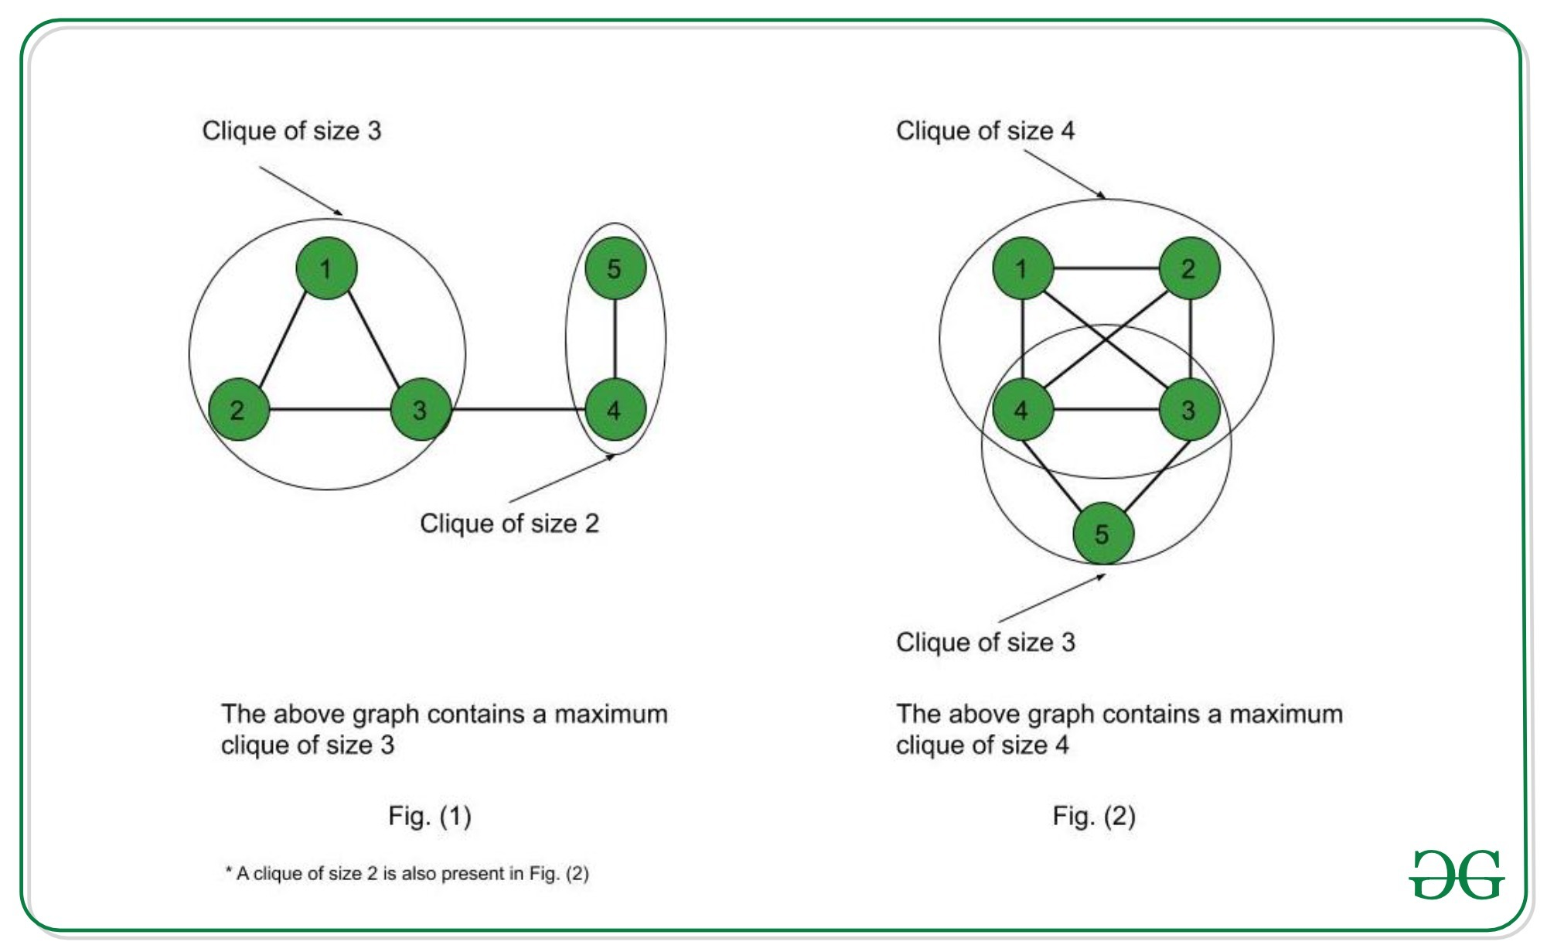

Slide 40



What is a clique?
A clique is a subgraph of a graph such that all the vertices in this subgraph are connected with each other that is the subgraph is a complete graph.
Fig (a) not a complete graph .but one of its subgraph is a complete graph of 4 vertices. Such subgraph which is complete is called clique
1
2
3
clique
4
5

Slide 41
Example
Here we can fine complete graph with 4 vertices,3 vertices,and 2 vertices .ie-K=4,K=3,K=2
1
2
4
3
5
6

Slide 42
Decision version of clique problem
Given a graph G and an integer K,decide if a G has a clique of size k? (ans will be yes /No)
Example consider fig a-
  is this graph has a clique of size 4?

Slide 43
Optimization problem
Find maximum clique in a graph

Slide 44
Clique decision problem
It is a graph problem
We need to prove that clique decision problem is NP hard.
If clique decision problem is NP hard, click optimization problem is NP hard
Problem definition
Clique Decision Problem is to find if a clique of size k exists in the given graph or not.

Slide 45
Prove that clique problem is NP Complete
In order to prove that clique problem is NPC ,we need to prove that
Clique problem is NP
Clique problem is NP hard

Slide 46

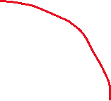



Commonly believed relationship among P, NP,
NP- Complete and NP- Hard problems
NP
NP-hard
P
NP-complete

Slide 47
How to prove that Clique problem is NP
For that we need to prove that clique problem can be verified in polynomial time.
Suppose a graph G is given and a set pf vertices of size K is also given ,we can verify in polynomial time that whether the graph contains a clique with that set of vertices (of size K).
this verification can be done in polynomial time.
Therefore, clique decision problem is NP

Slide 48




For eg-
1
2
4
3
5

Slide 49
Consider this graph G and a set s={1,2,3,4}, we can verify whether there exist a clique with these vertices in S.
This verification can be done in polinomial time
Hence, we can prove that clique problem is NP

Slide 50
How to prove that clique problem is NP hard
Take an NP problem and reduce that problem in polynomial time to clique problem
Here we are taking Independent set Problem,which is an NP problem, and we can reduce that problem in polynomial time to clique problem.

Slide 51
Independent set meaning
Consider the graph G,
S={1,2,3,4} is an independent set of G.
Means if we take any pair of vertices in U ,we cannot find an edge between them in G
Definition of Independent set
An Independent Set S of graph G = (V, E) is a set of vertices such that no two vertices in S are adjacent to each other.
G
1
2
4
3
5

Slide 52

Independent set Problem
Given a graph G(V, E) and an integer k, decide if the graph contains an independent set of vertices of size =k.?

Slide 53
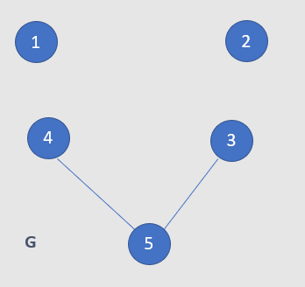
Consider the following graph G
Here S={1,2,3,4} is an independent set of size 4
Create the complement G’ of G

Slide 54






2
G’ can be created by addition and deletion of edges
Here G’ contains a clique of size K=4,
Thus, we reduced clique of size 4 from Independent set of size 4 in G, which can do in polynomial time
Now take the graph G’,it consist of a clique of size 4,if we take the vertices of clique in G’,these vertices are elements of independent set in G,which is of size 4
Thus, we created independent set problem from clique problem
Thus we can prove that clique problem is NP hard
1
4
3
5
G’

Slide 55
We have proved clique is
NP problem
NP hard problem
Thus, we have proved that clique decision problem in NP Complete

Slide 56

prove that Vertex Cover problem is NP Complete

Slide 57
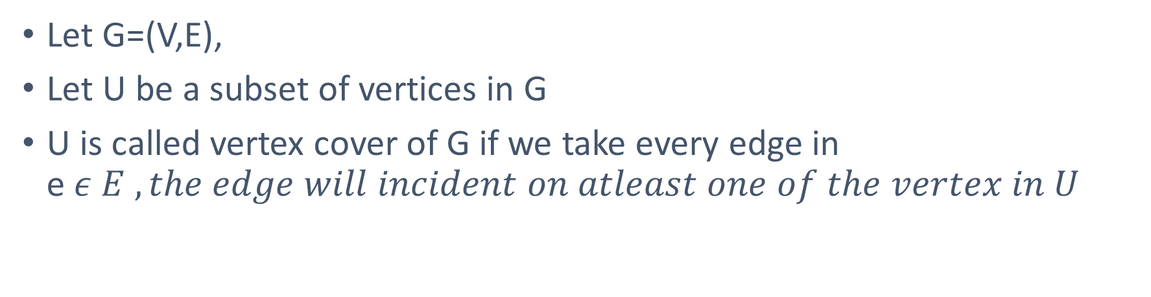
Meaning of vertex cover
Let G=(V,E),
Let U be a subset of vertices in G
U is called vertex cover of G if we take every edge in e$ε E , the edge will incident on atleast one of the vertex in U$

Slide 58





a
Consider this graph G,
Let U={1,2,3}
The set U is a vertex cover of G ,since each vertex in G incident on atleast one vertex in U
1
2
e
b
d
4
3
c

Slide 59

Vertex cover prolem
Given a graph G and an integer K. Decide if we can make a vertex cover with K number of vertices?
Example (G,3) -

Slide 60
In order to prove that vertex cover problem is NP complete, we need to prove that
Vertex cover problem is NP
Vertex cover problem is NP hard

Slide 61
1.Vertex cover problem is NP
If a graph and a set of vertices U is given ,we can check if each edge e in E is incident on at least one vertex in G
We can verify this in polynomial time which means vertex cover problem is NP

Slide 62
Example
a
Consider this graph G,
Let U={1,2,3}
The set U is a vertex cover of G ,since each vertex in G incident on atleast one vertex in U
1
2
e
b
d
4
3
c

Slide 63

2.Vertex cover problem is NP hard
Here we are taking independent set problem ,which is an NP hard problem and we can reduce it in polynomial time to VC problem
IS VC

Slide 64
First let us understand the notion of an instance of a problem.
An instance of a problem is nothing but an input to the given problem.
An instance of the Vertex Cover problem is a graph G (V, E) and a positive integer k, and the problem is to check whether a vertex cover of size at most k exists in G.
Take an instance of independent set problem Independent Set(G,4)
We can make an independent set S={1,2,3,4} K means size of S
2
1
3
5
4
a

Slide 65
In this example,S is a vertex set in G
Take V-S, where V is set of vertices in given graph
Here V= {1,2,3,4,5}
V-S={5}
In this graph {5} is a vertex cover of size 1
That means if S is an independent set in G with K number of vertices,V-S will be a vertex cover in G with n-k number of vertices ,where n means total number of vertices in G

Slide 66
From one instance of independent set problem, we created a vertex cover problem, and the reduction was done in polynomial time
There fore vertex cover problem is an NP hard problem
Since vertex cover problem is NP and Np hard ,it is an NP complete problem

